Slide 1

Weekly Progress Report
PINN Codebase Refactoring & Exploratory Trials
By Sai Kumar Garlapati
Notes:
This report summarizes the restructuring of the PINN codebase and exploratory trial runs performed using two different preprocessing strategies, focusing on understanding model behavior rather than drawing conclusions.

Slide 2
Purpose of This Week’s Work
Understand existing PINN implementation
Identify structural and design limitations
Refactor into modular architecture
Enable experimentation with preprocessing strategies
Compare behavior of two code versions
Notes:
At this stage, the goal is not performance optimization but clarity, control, and understanding of how different components influence results.

Slide 3
Initial Codebase: Observations
Single monolithic script (1700+ LOC)
Mixed responsibilities across functions
Implicit execution order
Difficult to isolate components
Hard to experiment safely
Notes:
Making changes in the original code risked unintended side effects, which motivated a deeper structural analysis.

Slide 4
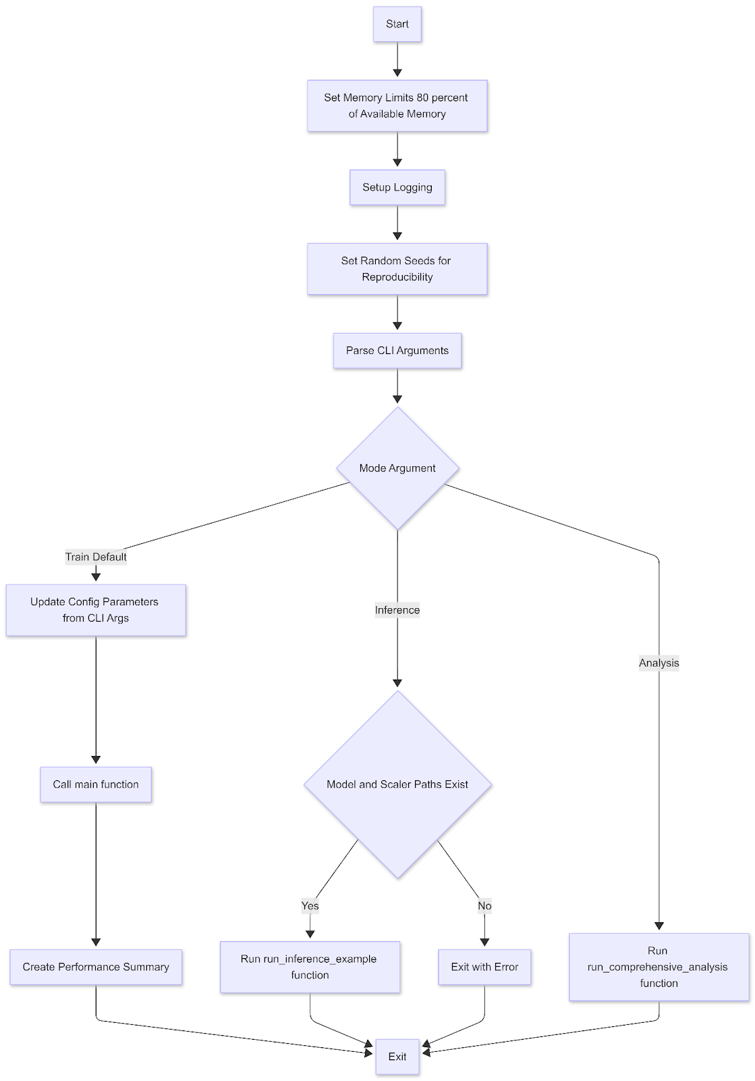
Understanding the Original Code Flow
Traced execution from entry point
Identified data flow and dependencies
Documented control flow step-by-step
Converted understanding into flowcharts
Notes:
Creating flowcharts was essential to understand how data, model, and training logic were intertwined.

Slide 5
Motivation for Modular Redesign
Why Modularize?
Improve readability
Enable isolated testing
Allow controlled experimentation
Prepare for future PINN extensions
Align with research software standards
Notes:
PINN experiments require frequent changes. A modular design makes such experimentation feasible and safe.

Slide 6
Modular Design Strategy
Design Principles Used
Single Responsibility Principle
Clear separation of concerns
Explicit data flow
Minimal coupling between modules
Notes:
Each module was designed to answer a single question: data handling, physics logic, model definition, or execution control.

Slide 7
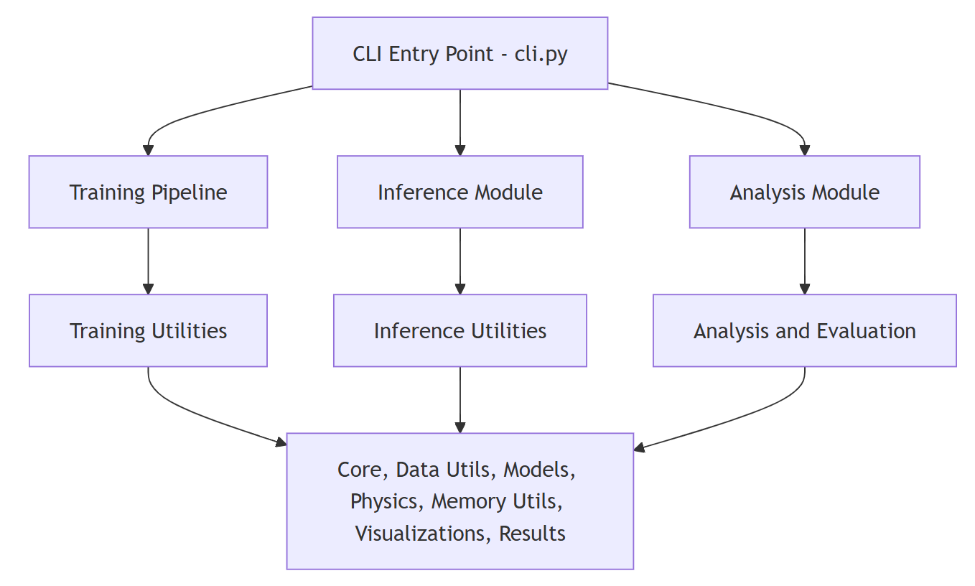
Function-to-Module Mapping
Notes:
This mapping was derived directly from understanding the original execution flow, not imposed arbitrarily.

Slide 8
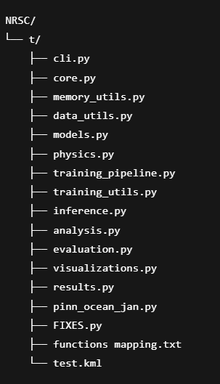
Directory Structure

Slide 9
Two Code Versions Created
Code Versions
Version A: Baseline (closer to original logic)
Version B: Modified ocean mask & interpolation logic
All other components kept identical.
Notes:
Only preprocessing-related logic was changed to ensure fair comparison and controlled experimentation.

Slide 10
Trial Runs Performed
Two weeks of real dataset
Both versions run on same data
Outputs plotted and compared
No training conclusions drawn yet

Slide 11
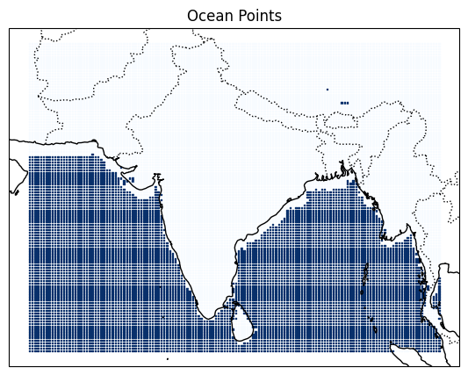
Spatial Visualization of Selected Points

Slide 12
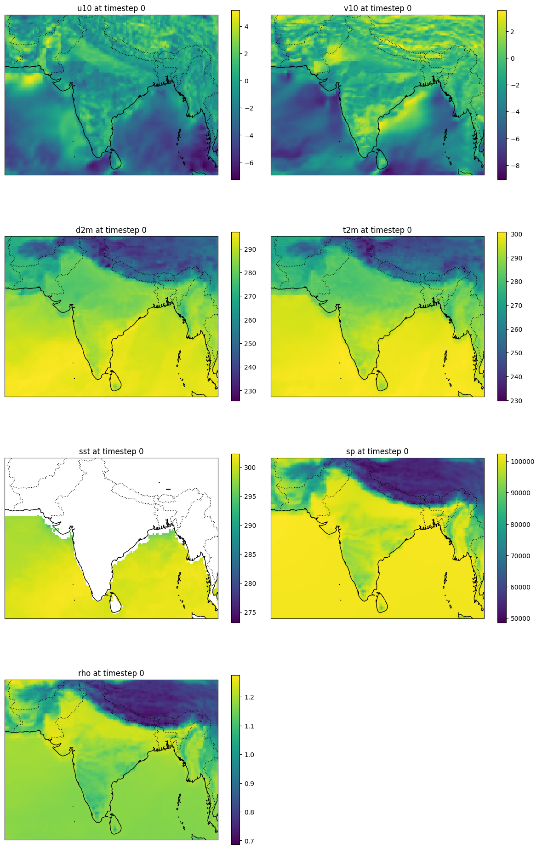
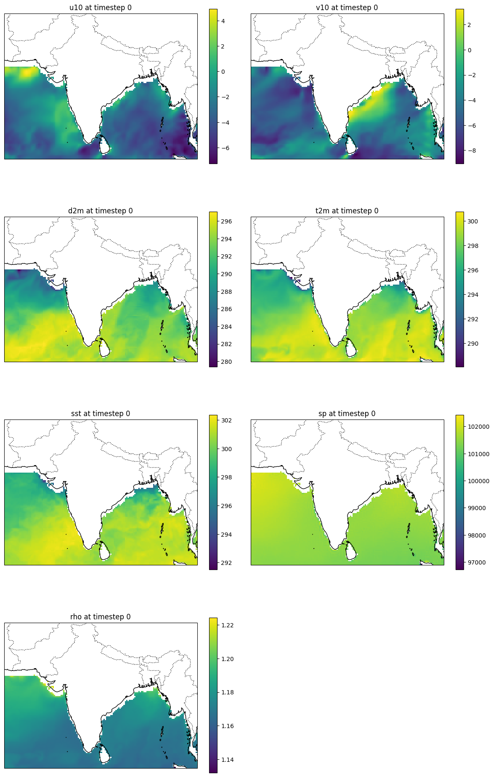

Slide 14
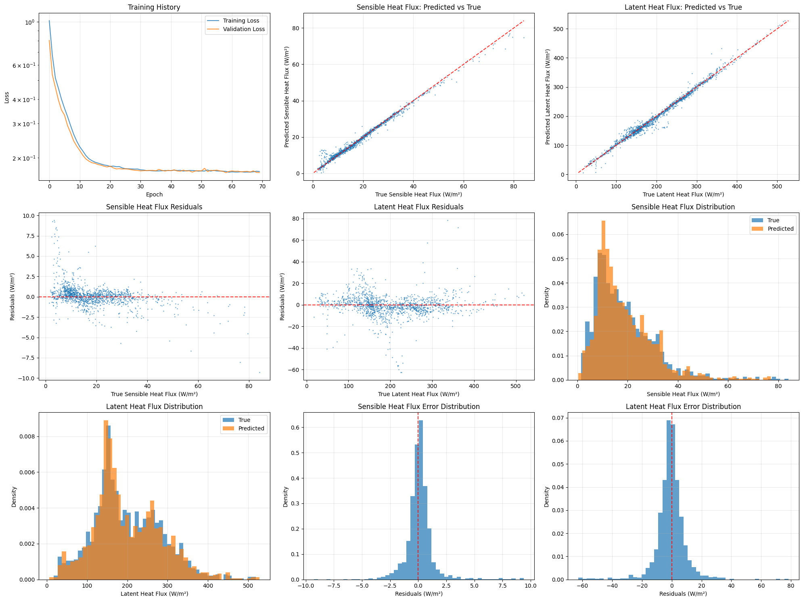
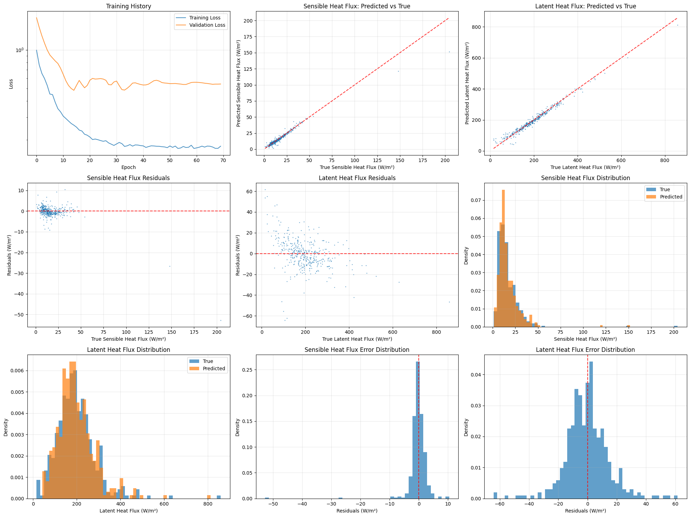
RESULTS

Slide 15
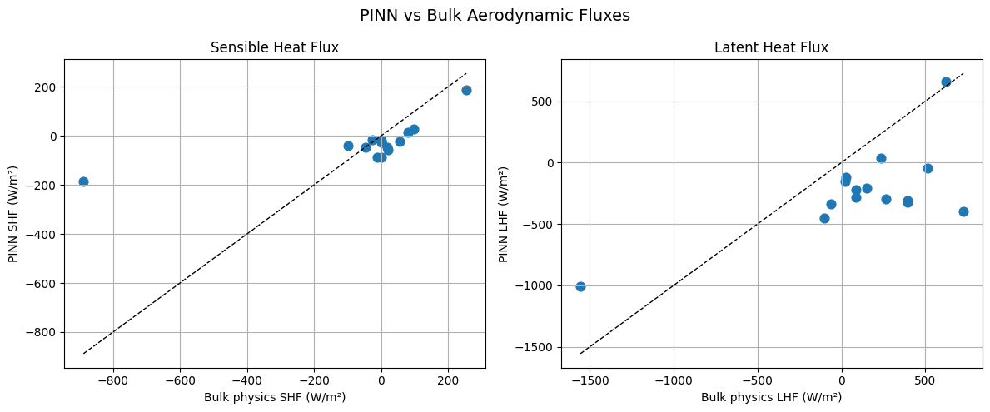

Slide 16
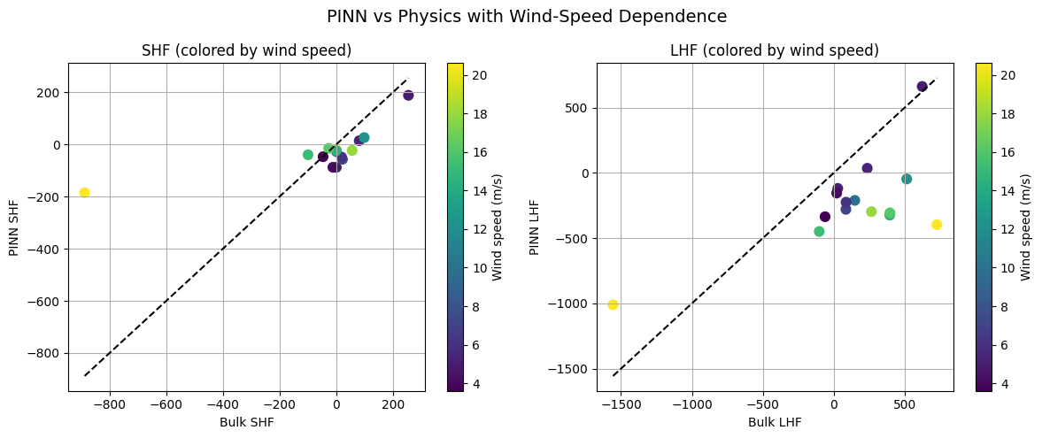

Slide 17
Key Takeaways (THIS WEEK)
Original code structure is hard to extend
Modular design improves understanding
Small preprocessing changes have large effects
Visualization aids debugging

Slide 18
Current Status
Modular framework ready
Two preprocessing strategies implemented
Trial runs completed
Understanding phase ongoing

